Slide 1

UE20CS390A – CAPSTONE PROJECT APPROVAL
Removal of fog from videos
Project ID: PW23_SSS_06
Project Guide: Dr. Shylaja S
Team Members
Harsha R Patil (PES1UG21812)
Hritik Sharma (PES1UG21814)
Priya Gawli (PES1UG21829)
Zia Ur Rehman (PES1UG21845)

Slide 2
Real time removal of fog from videos
Outline
Problem Statement
What is Fog and Defogging?
Why Defogging?
Applications
Scope and Feasibility study
Dataset
Expected Deliverables
Capstone (Phase-I & Phase-II) Project Timeline
References
Harsha, Hritik, Priya, Zia

Slide 3
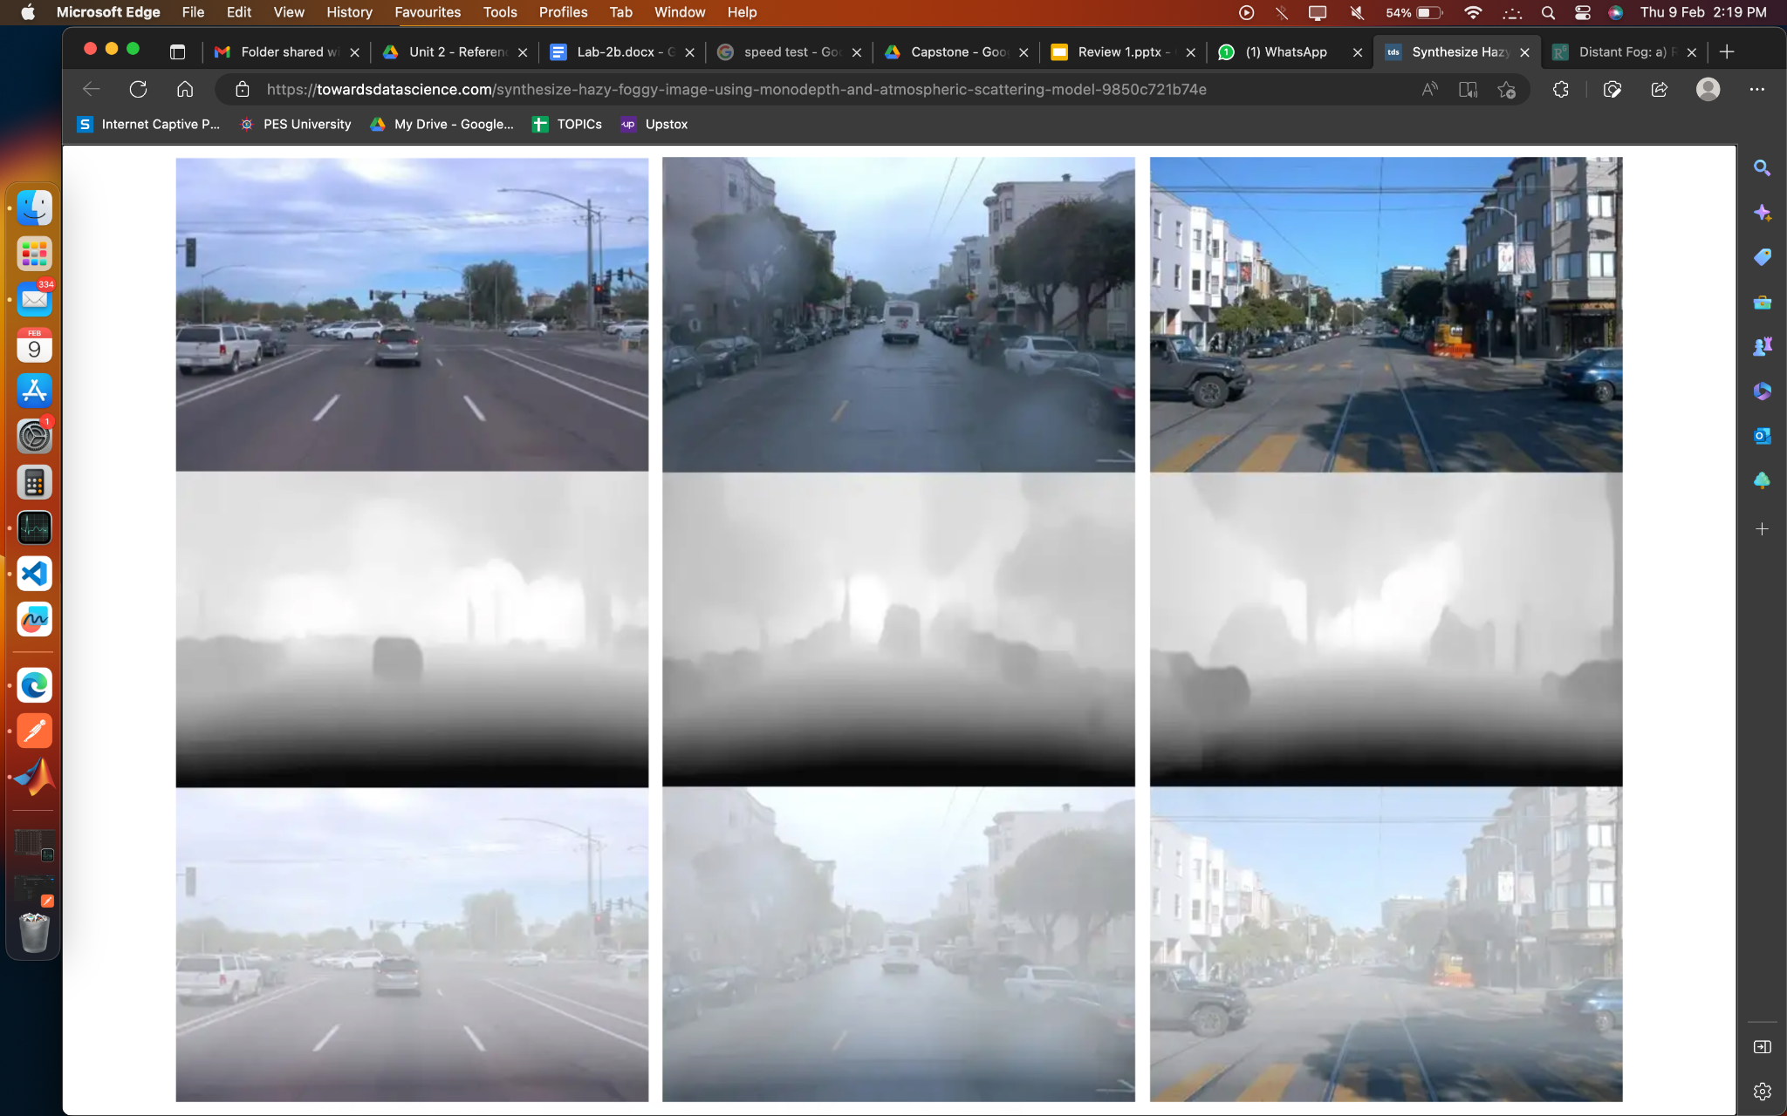
Harsha, Hritik, Priya, Zia

Slide 4
Removal of fog from videos
Problem Statement
In current video capture systems, poor visibility due to foggy conditions can significantly reduce the quality of captured footage, leading to unclear images and loss of important information. This negatively impacts the ability to use video footage for surveillance, documentation, or other applications.
There is a need for a solution that can effectively remove or reduce the fog effect in video to improve the visibility and usability of the captured footage.
Harsha, Hritik, Priya, Zia

Slide 5

What is Fog and Defogging?
Harsha, Hritik, Priya, Zia

Slide 6
Real time removal of fog from videos
Scope
Classify foggy input from non foggy input and then classify them based on fog density level.
Estimate optical flow of objects, atmospheric light, transmission map using various techniques like Lucas-Kanade, Horn shnuck, histogram-based methods or gradient-based methods.
Remove fog from video by dividing the original foggy image by the estimated transmission map.
Harsha, Hritik, Priya, Zia

Slide 7
Why Defogging?
1
Improved visibility
Provide a clearer view of the scene.
2
Better image quality
Enhance the image quality and make it more visually appealing.
Improved accuracy
In fields such as autonomous driving, removing fog can help improve the accuracy of perception.
3
Harsha, Hritik, Priya, Zia

Slide 8




Applications
Autonomous vehicles
Surveillance
Weather forecasting
Environmental monitoring
Harsha, Hritik, Priya, Zia

Slide 9
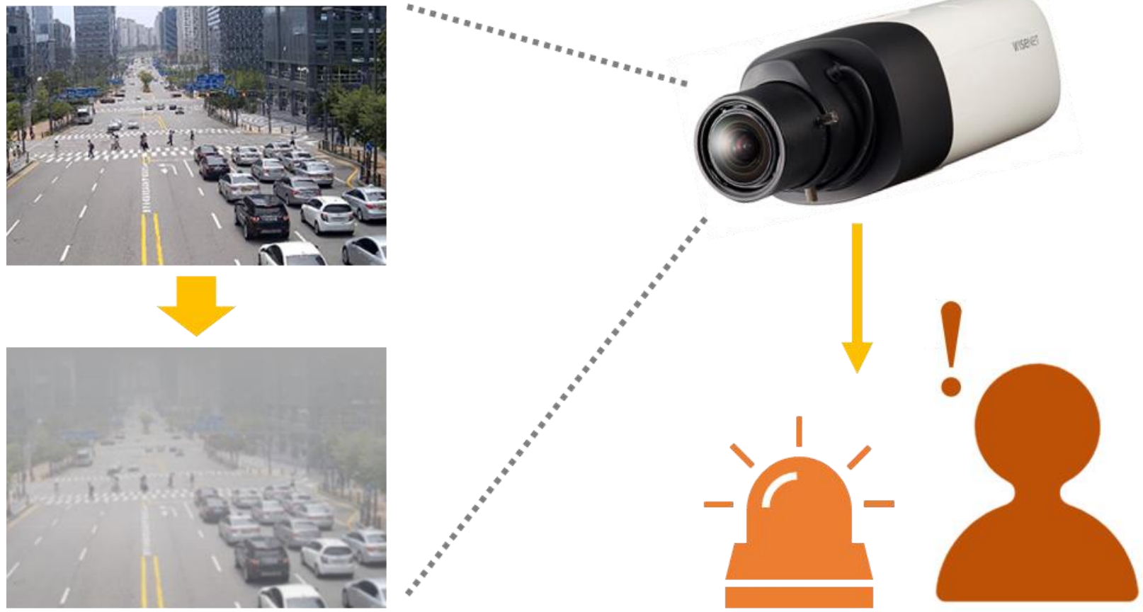
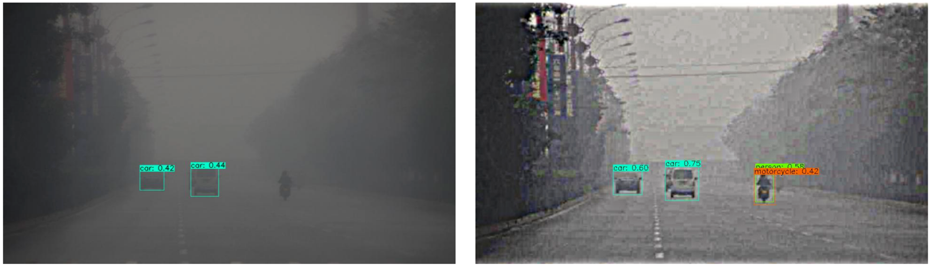
Example
Usage of defogged image in Surveillance
Usage of defogged image in automated vehicle
Harsha, Hritik, Priya, Zia

Slide 10


Real time removal of fog from videos
Feasibility study
In general, real-time defogging is possible for relatively simple scenes with lower resolution videos and limited computational resources. For larger videos with complex scenes, the processing time may be significantly higher, and it may not be possible to perform defogging in real-time.
Your video is too large
Data availability: Foggy videos may be difficult to obtain, especially in large quantities, and may require specialized equipment to capture. This can limit the size and diversity of the dataset and may negatively impact the performance of the machine learning models.
Harsha, Hritik, Priya, Zia

Slide 11

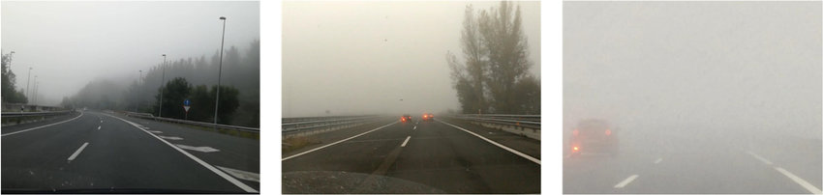
Real time removal of fog from videos
Contd..
Decreasing the resolution of the video can reduce the amount of data that needs to be processed, which can result in a significant decrease in processing time.
Data quality: It is important to ensure that the foggy videos in the dataset are representative of the types of fog that are likely to be encountered in real-world scenarios. This may require collecting data under different weather conditions and with different levels of fog intensity.
Data with varying fog intensity
Harsha, Hritik, Priya, Zia

Slide 12

Dataset
Link to dataset:
https://data.vision.ee.ethz.ch/cvl/ntire19//dense-haze/
Harsha, Hritik, Priya, Zia

Slide 13
Real time removal of fog from videos
Expected Deliverables
Capstone-I deliverables
Clear Problem Statement
Dataset for training and testing the model
Approach to solve the problem
Literature Survey
Capstone-II deliverables
Complete model
High level Architecture Design
Harsha, Hritik, Priya, Zia

Slide 14
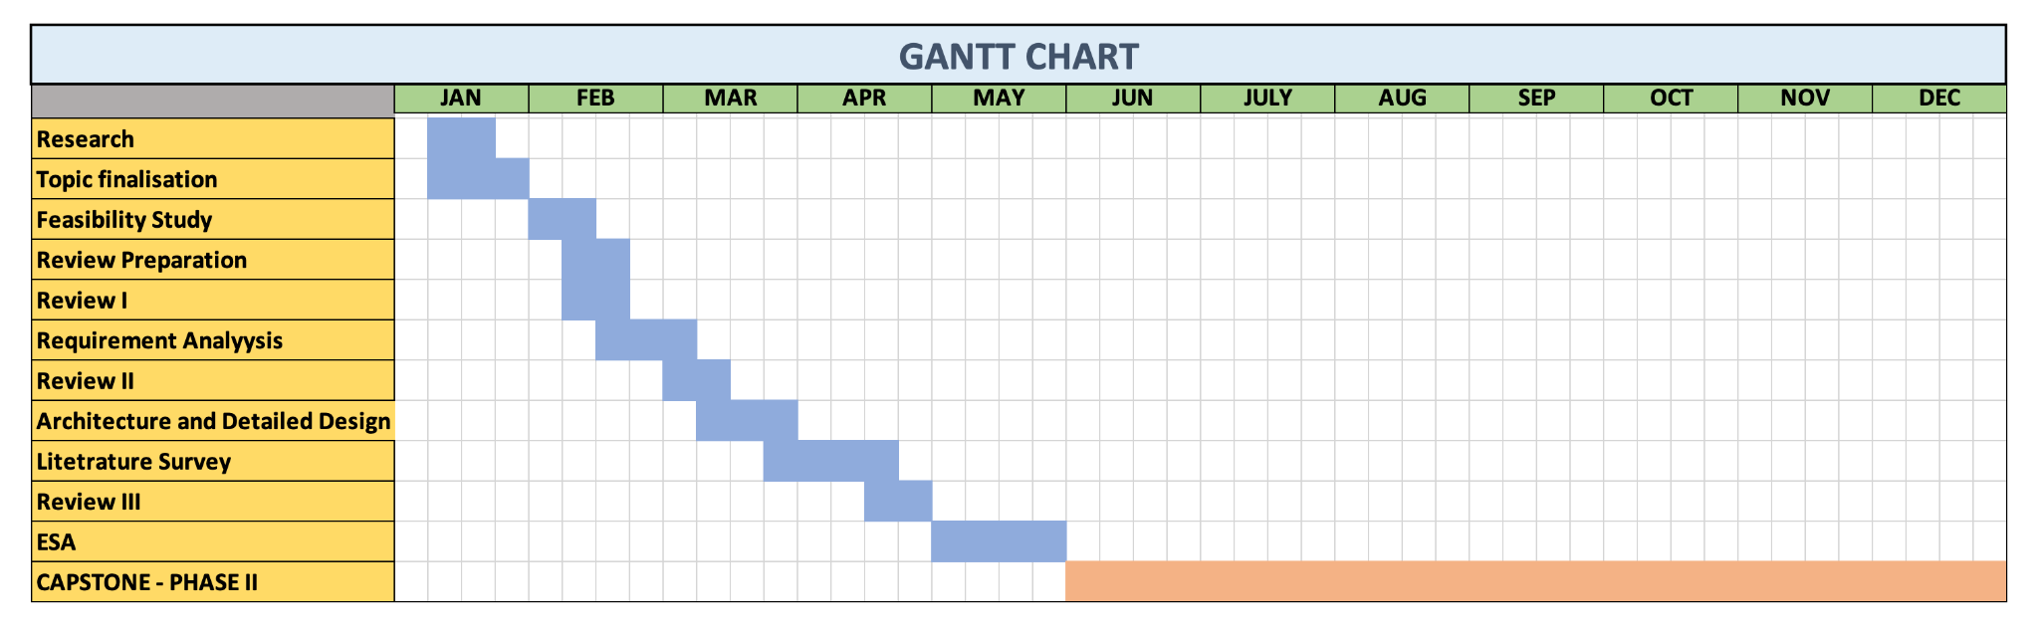
Real time removal of fog from videos
Capstone (Phase-I & Phase-II) Project Timeline
Harsha, Hritik, Priya, Zia

Slide 15
References
Title | Link
1. Optical Flow in Dense Foggy Scenes using Semi-Supervised Learning | https://openaccess.thecvf.com/content_CVPR_2020/papers/Yan_Optical_Flow_in_Dense_Foggy_Scenes_Using_Semi-Supervised_Learning_CVPR_2020_paper.pdf
2. Review of Video and Image Defogging Algorithms and Related Studies on Image Restoration and Enhancement | https://ieeexplore.ieee.org/stamp/stamp.jsp?tp=&arnumber=7365412
3. Foggy Scene Rendering Based on Transmission Map Estimation | https://dl.acm.org/doi/pdf/10.1155/2014/308629
Harsha, Hritik, Priya, Zia

Slide 16
Thank You

